Slide 1
The Flow of Genetic Information
The information content of DNA is in the form of specific sequences of nucleotides
The DNA inherited by an organism leads to specific traits by dictating the synthesis of proteins
Proteins are the links between genotype and phenotype
Gene expression, the process by which DNA directs protein synthesis, includes two stages: transcription and translation

Slide 2
The Products of Gene Expression:
A .Developing Story
Some proteins aren’t enzymes, so researchers later revised the hypothesis: one gene–one protein
Many proteins are composed of several polypeptides, each of which has its own gene
Therefore, Beadle and Tatum’s hypothesis is now restated as the one gene–one polypeptide hypothesis

Slide 3
RNA is the bridge between genes and the proteins for which they code
Transcription is the synthesis of RNA using information in DNA
Transcription produces messenger RNA (mRNA)
Translation is the synthesis of a polypeptide, using information in the mRNA
Ribosomes are the sites of translation

Slide 4
In prokaryotes, translation of mRNA can begin before transcription has finished
In a eukaryotic cell, the nuclear envelope separates transcription from translation
Eukaryotic RNA transcripts are modified through RNA processing to yield the finished mRNA
A primary transcript is the initial RNA transcript from any gene prior to processing
The central dogma is the concept that cells are governed by a cellular chain of command:
DNA → RNA → protein

Slide 5
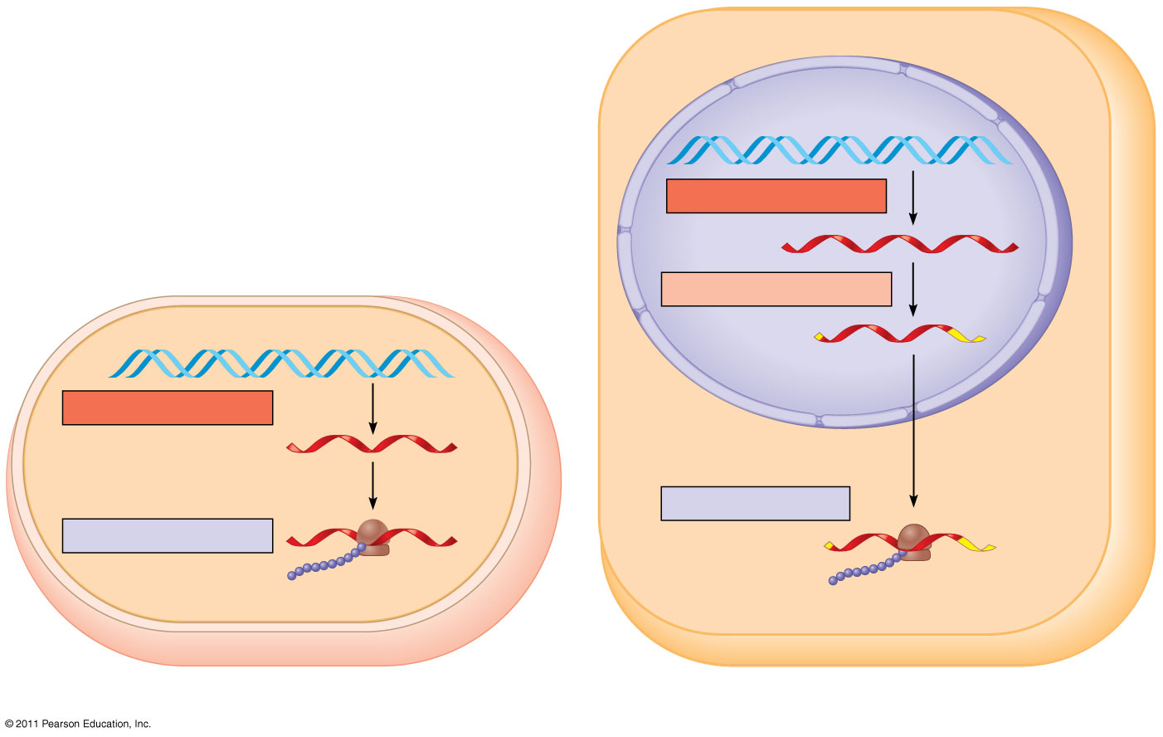
Nuclear envelope
TRANSCRIPTION
DNA
RNA PROCESSING
Pre-mRNA
mRNA
TRANSCRIPTION
DNA
mRNA
Ribosome
TRANSLATION
Ribosome
TRANSLATION
Polypeptide
Polypeptide
(a) Bacterial cell
(b) Eukaryotic cell

Slide 6
Codons: Triplets of Nucleotides
The flow of information from gene to protein is based on a triplet code: a series of nonoverlapping, three-nucleotide words
The words of a gene are transcribed into complementary nonoverlapping three-nucleotide words of mRNA
These words are then translated into a chain of amino acids, forming a polypeptide

Slide 7
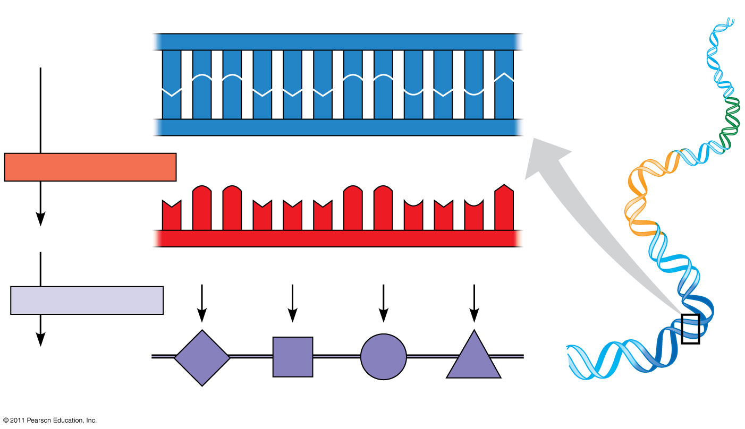
Figure 17.4
DNA template strand
3′
5′
DNA
A
C
C
A
A
A
C
C
G
A
G
T
molecule
T
G
G
T
T
T
G
G
C
T
C
A
Gene 1
5′
3′
TRANSCRIPTION
Gene 2
U
G
G
U
U
U
G
G
C
U
C
A
5′
3′
mRNA
Codon
TRANSLATION
Protein
Trp
Phe
Gly
Ser
Gene 3
Amino acid
Notes:
Figure 17.4 The triplet code.

Slide 8
During transcription, one of the two DNA strands, called the template strand, provides a template for ordering the sequence of complementary nucleotides in an RNA transcript
The template strand is always the same strand for a given gene
During translation, the mRNA base triplets, called codons, are read in the 5′ to 3′ direction

Slide 9
Codons along an mRNA molecule are read by translation machinery in the 5′ to 3′ direction
Each codon specifies the amino acid (one of 20) to be placed at the corresponding position along a polypeptide

Slide 10
Cracking the Code
All 64 codons were deciphered by the mid-1960s
Of the 64 triplets, 61 code for amino acids; 3 triplets are “stop” signals to end translation
The genetic code is redundant (more than one codon may specify a particular amino acid) but not ambiguous; no codon specifies more than one amino acid
Codons must be read in the correct reading frame (correct groupings) in order for the specified polypeptide to be produced

Slide 11
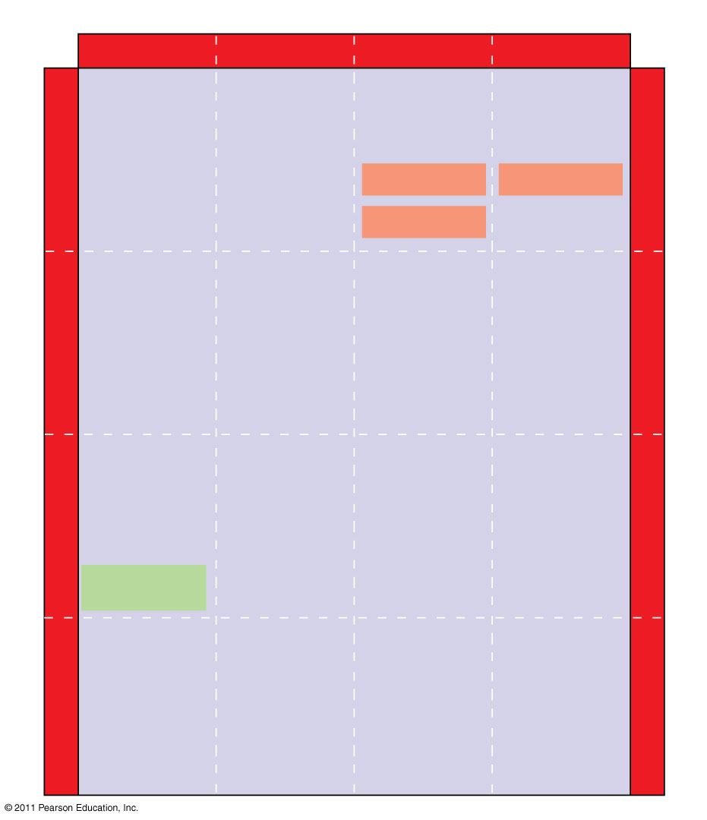
Figure 17.5
Second mRNA base
U
C
A
G
UUU
UCU
UAU
UGU
U
Phe
Tyr
Cys
U
UUC
UCC
UAC
UGC
C
Ser
UUA
UCA
UAA Stop
UGA Stop
A
Leu
UUG
UCG
UAG Stop
UGG
Trp
G
CUU
CCU
CAU
CGU
U
His
C
CUC
CCC
CAC
CGC
C
Leu
Pro
Arg
CUA
CCA
CAA
CGA
A
Gln
CUG
CCG
CAG
CGG
G
First mRNA base (5′ end of codon)
Third mRNA base (3′ end of codon)
AUU
ACU
AAU
AGU
U
Asn
Ser
A
AUC
Ile
ACC
AAC
AGC
C
Thr
AUA
ACA
AAA
AGA
A
Lys
Arg
AUG
Met or start
ACG
AAG
AGG
G
GUU
GCU
GAU
GGU
U
Asp
G
GUC
GCC
GAC
GGC
C
Val
Ala
Gly
Gly
GUA
GCA
GAA
GGA
A
Glu
GUG
GCG
GAG
GGG
G
Notes:
Figure 17.5 The codon table for mRNA.

Slide 12
Evolution of the Genetic Code
The genetic code is nearly universal, shared by the simplest bacteria to the most complex animals
Genes can be transcribed and translated after being transplanted from one species to another

Slide 13
Molecular Components of Transcription
RNA synthesis is catalyzed by RNA polymerase, which pries the DNA strands apart and hooks together the RNA nucleotides
The RNA is complementary to the DNA template strand
RNA synthesis follows the same base-pairing rules as DNA, except that uracil substitutes for thymine

Slide 14
The DNA sequence where RNA polymerase attaches is called the promoter; in bacteria, the sequence signaling the end of transcription is called the terminator
The stretch of DNA that is transcribed is called a transcription unit

Slide 15
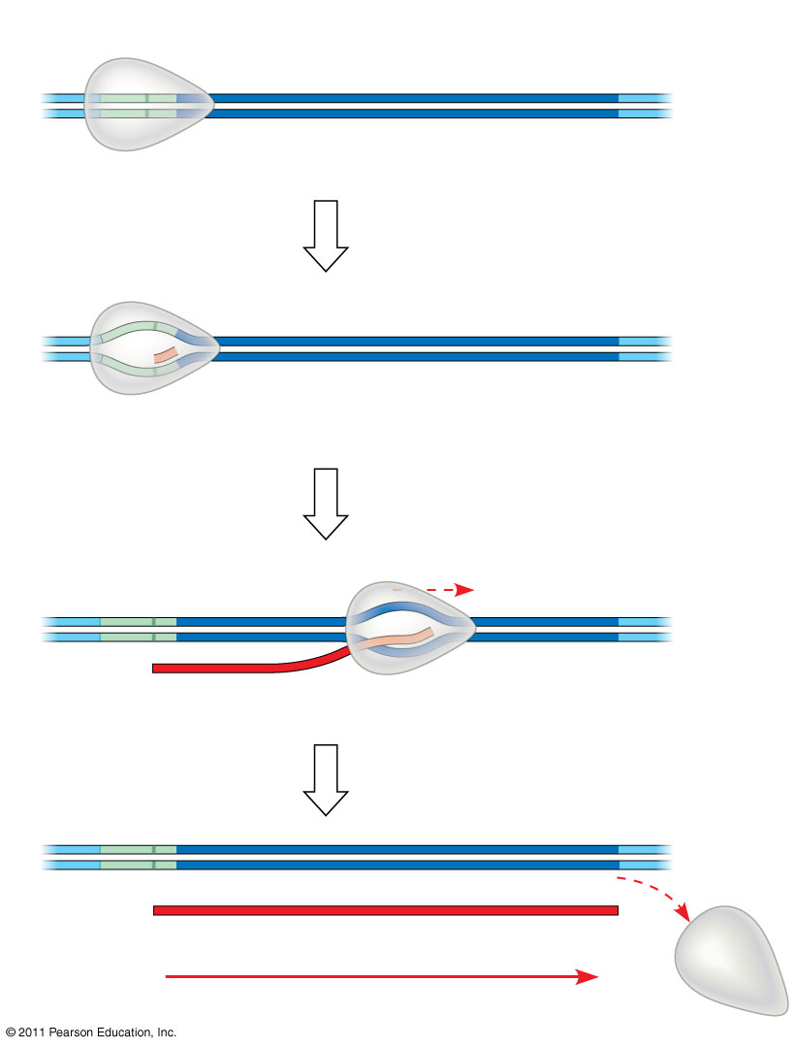
Figure 17.7-4
Promoter
Transcription unit
5′
3′
3′
DNA
5′
Start point
RNA polymerase
1
Initiation
Nontemplate strand of DNA
5′
3′
3′
5′
RNA transcript
Template strand of DNA
Unwound DNA
2
Elongation
Rewound DNA
5′
3′
3′
3′
5′
5′
RNA transcript
3
Termination
5′
3′
3′
5′
5′
Completed RNA transcript
3′
Direction of transcription (“downstream”)
Notes:
Figure 17.7 The stages of transcription: initiation, elongation, and termination.

